Slide 1


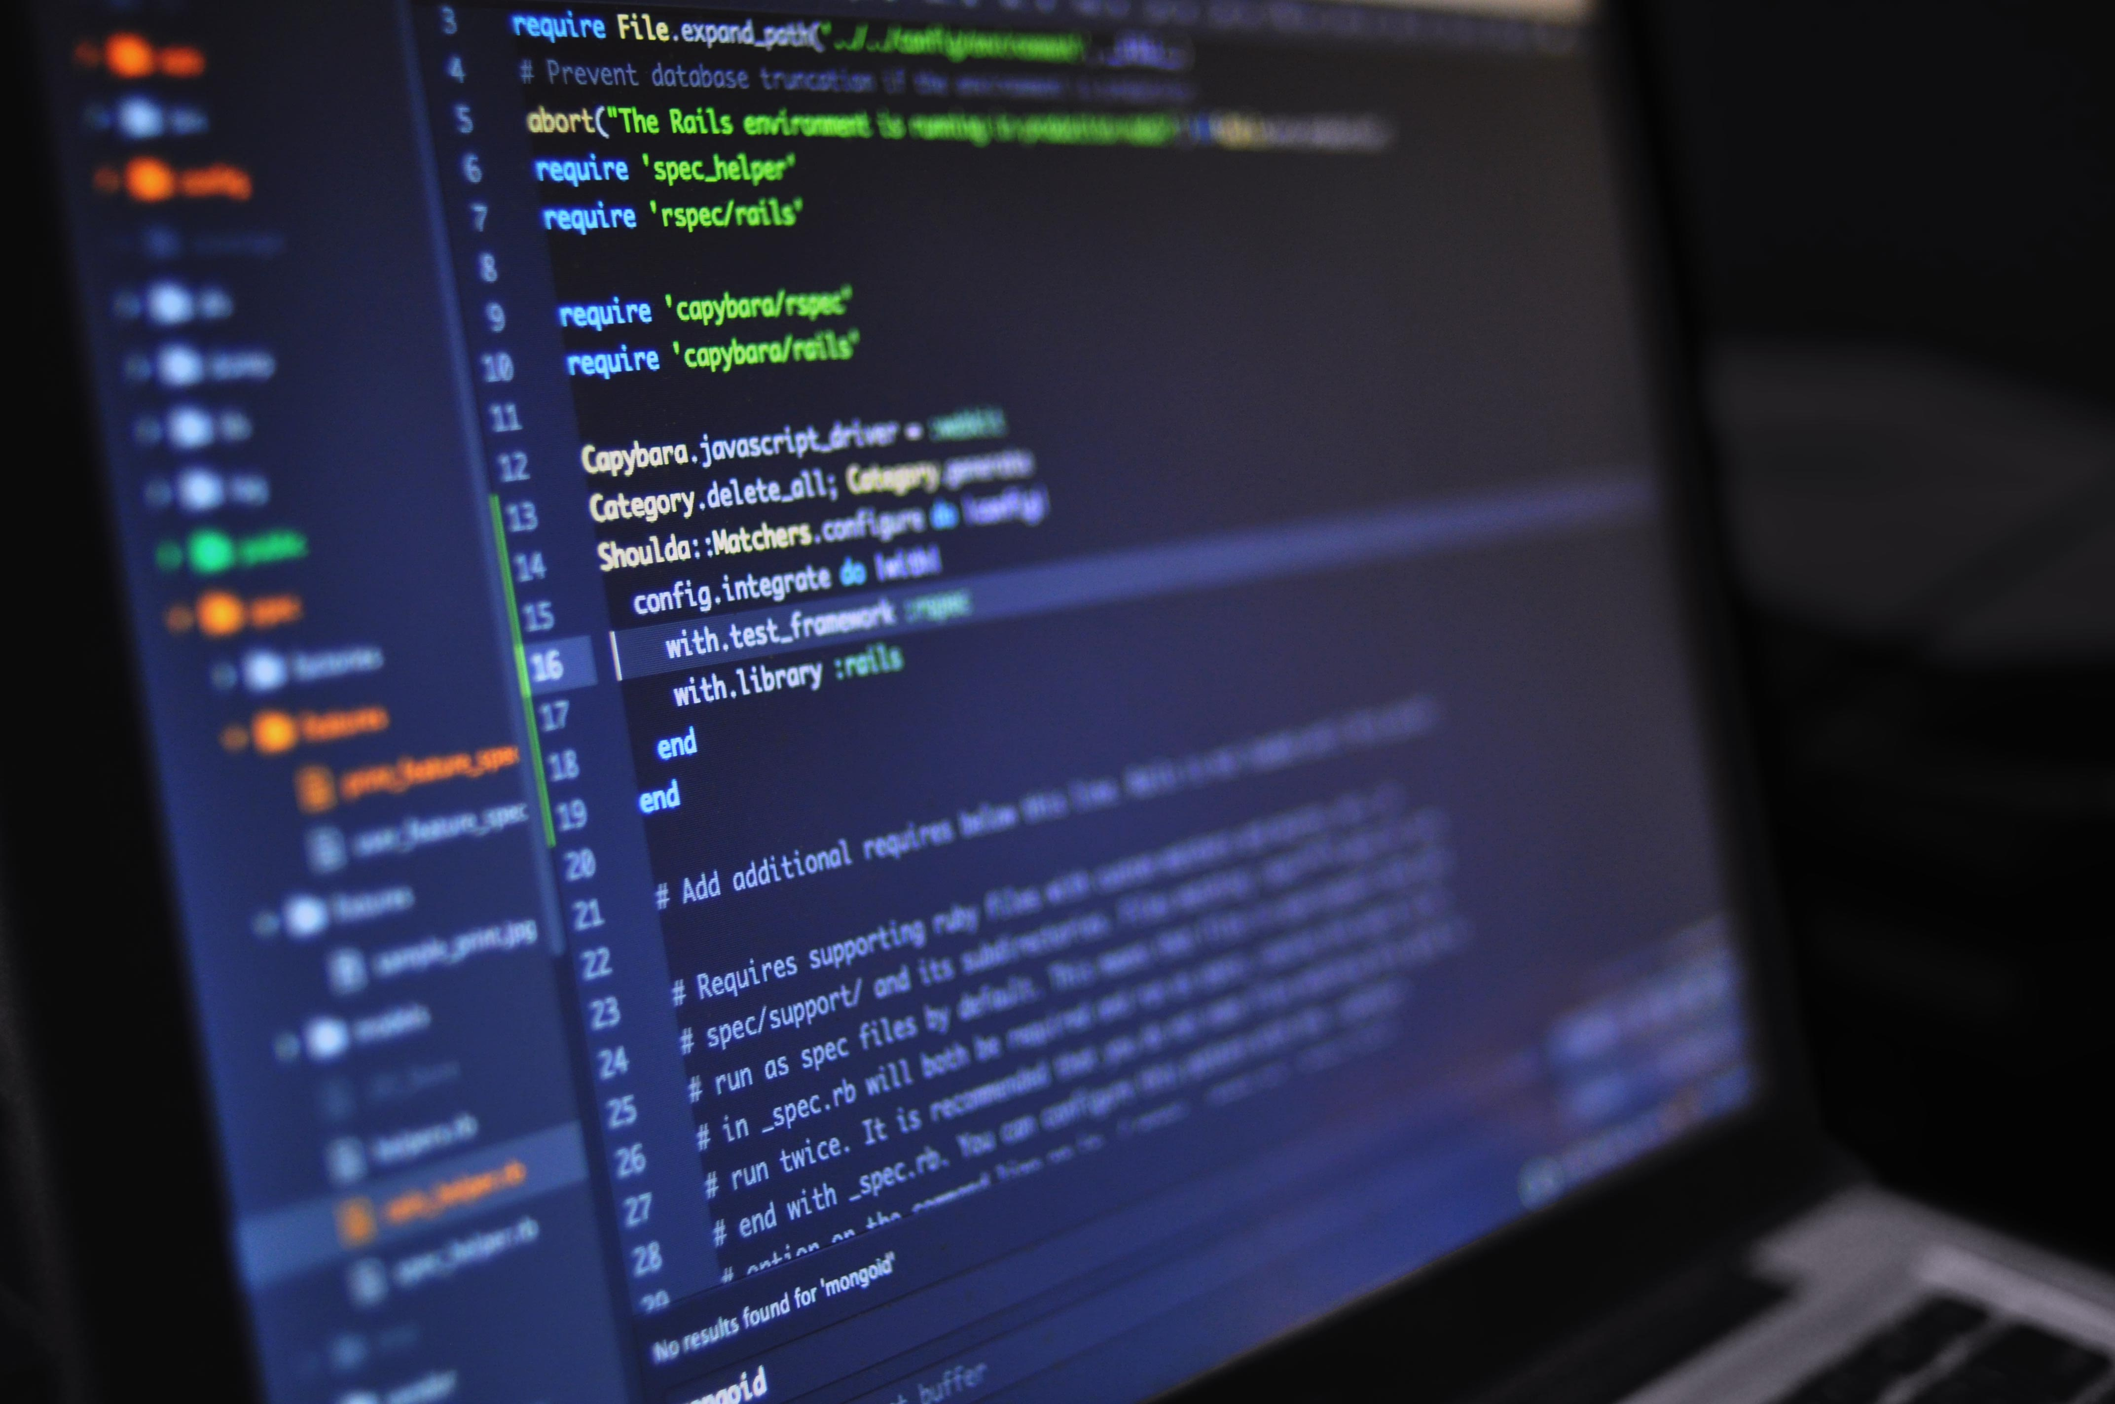
Python for beginners with applications
Write code from scratch in a clear & concise way, through a complete basic course. From beginners to intermediate.
Plotting and data-visualization in Python
Libraries : Matplotlib, Seaborn, Plotly
Abdesselam Filali 2026-04-22 18h00 Algiers time

